Slide 1
CleanRwith
Technology Backend
© CleanRwith International Limited September 2020

Slide 2
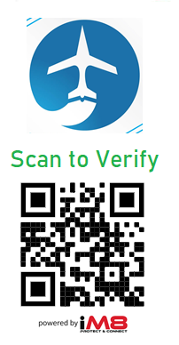
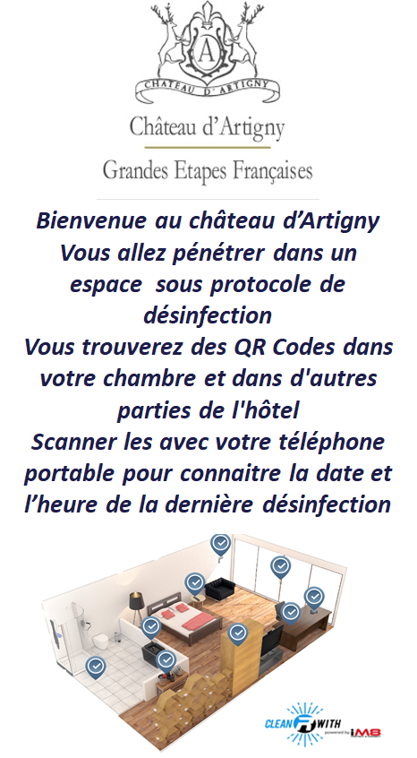
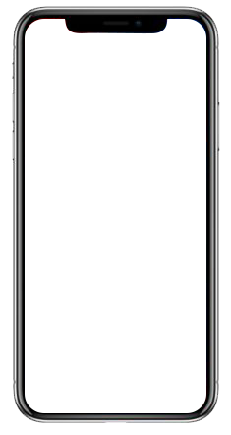
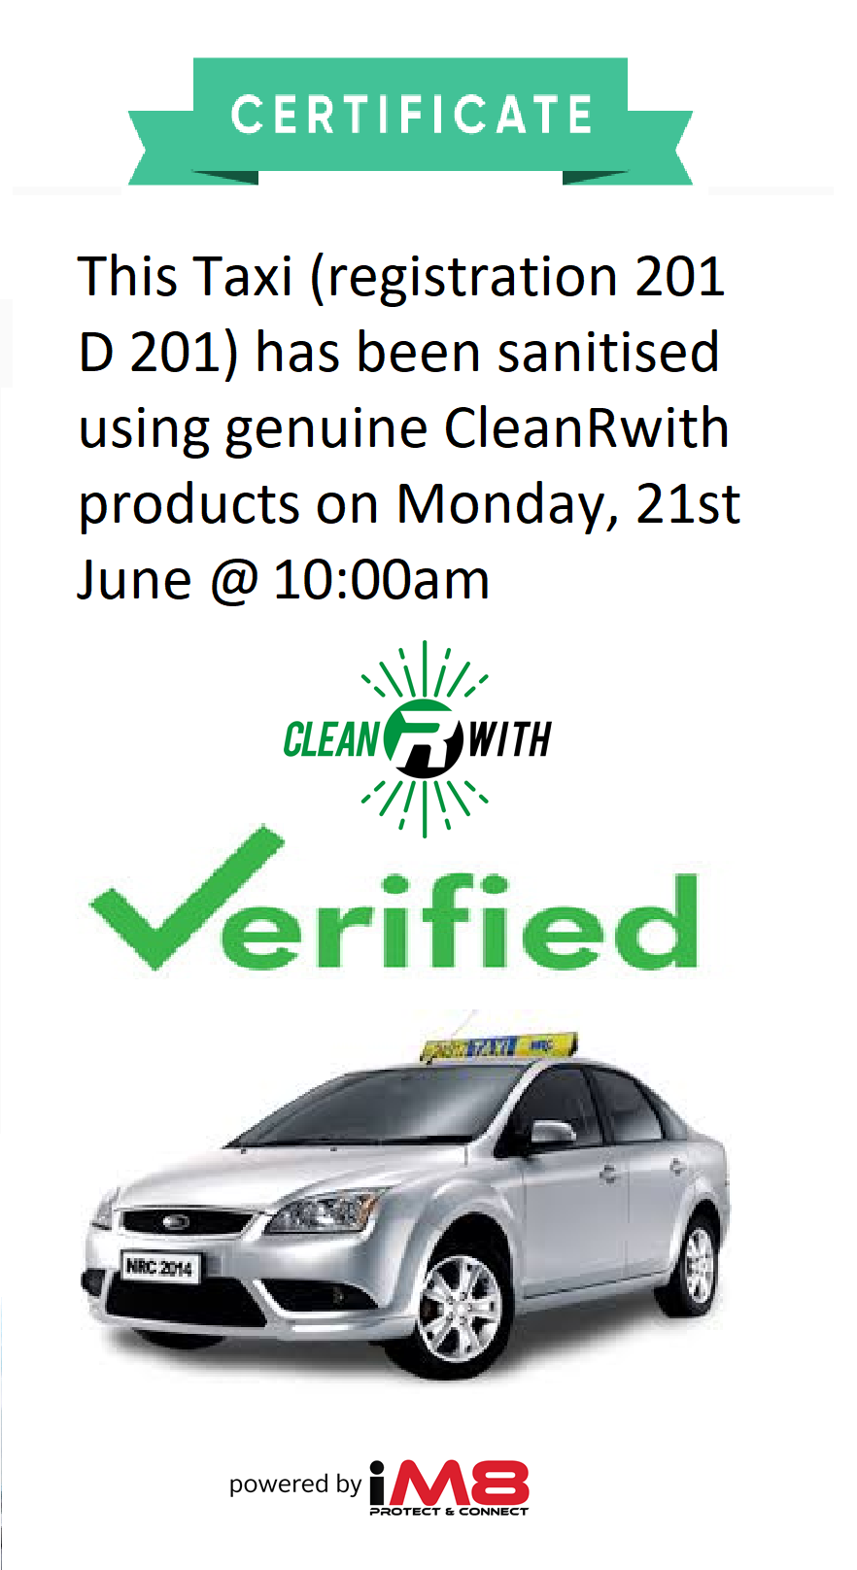
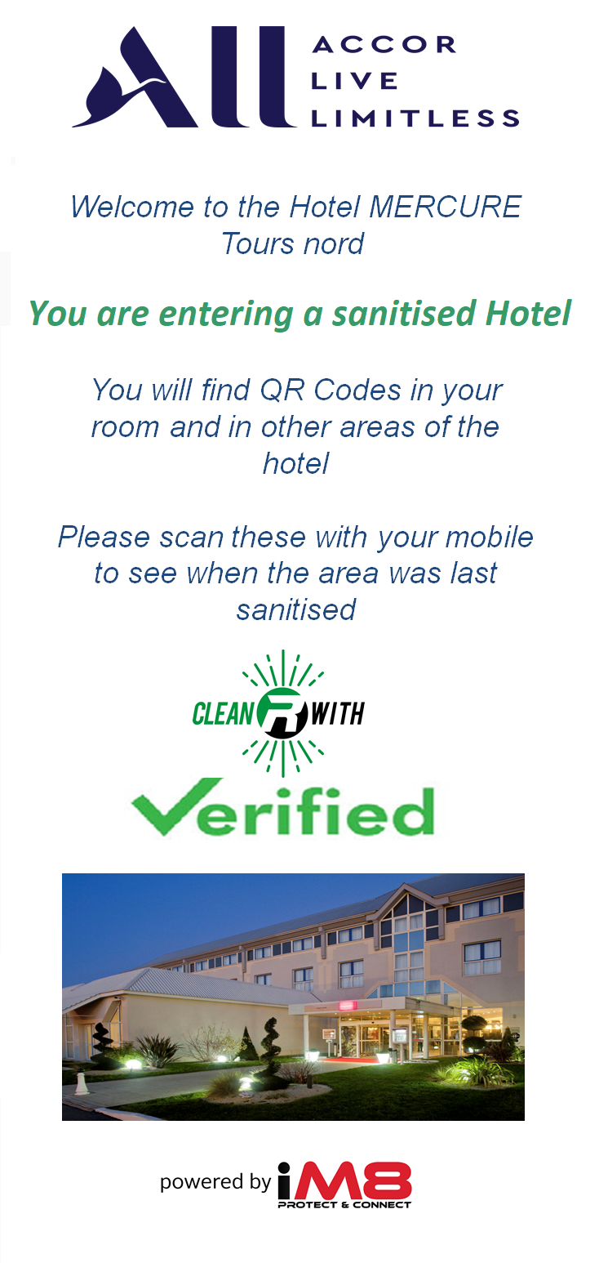

Unique Blockchain Verification Technology
Your customer uses their phone to scan the Blockchain secured QR code to receive instant sanitisation verification

Slide 3
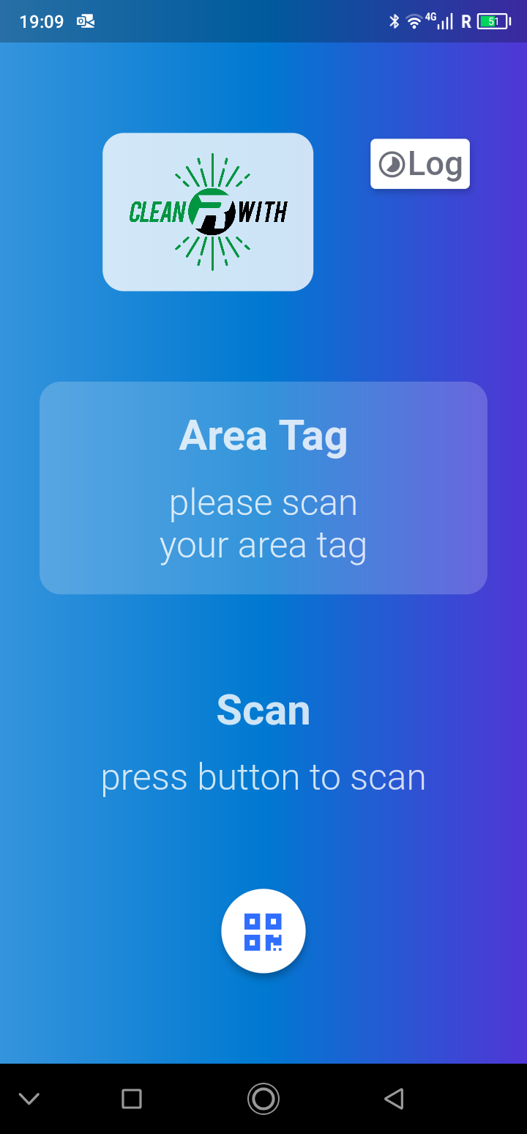
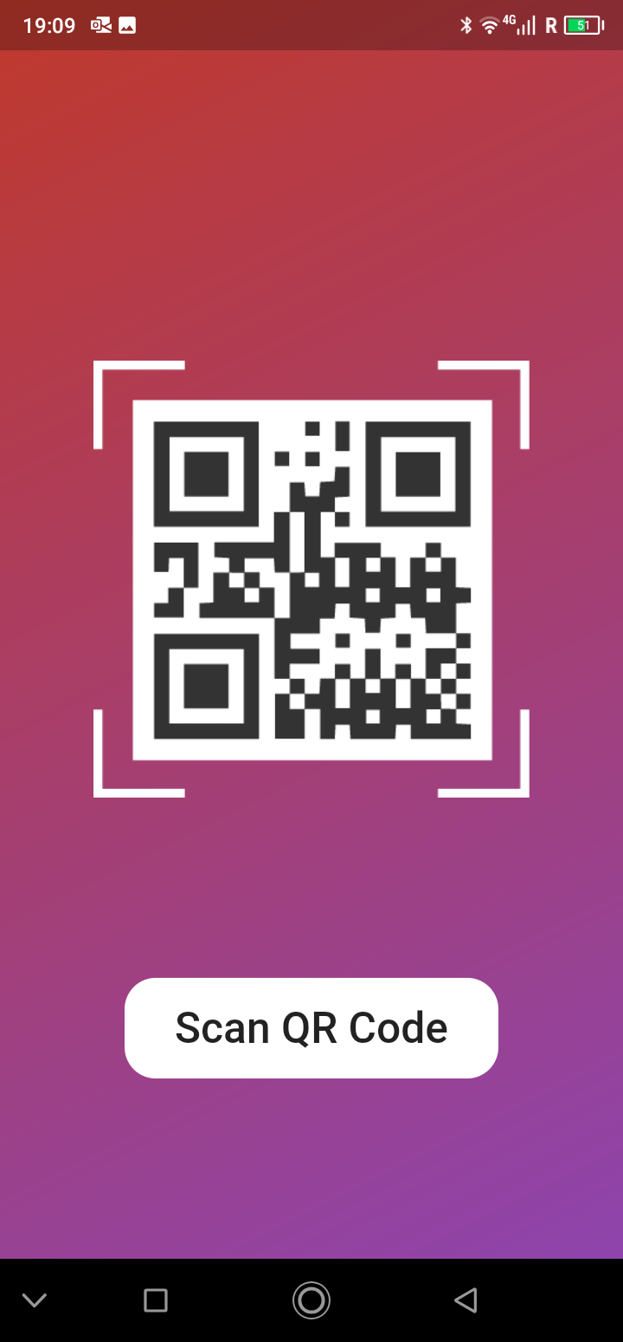
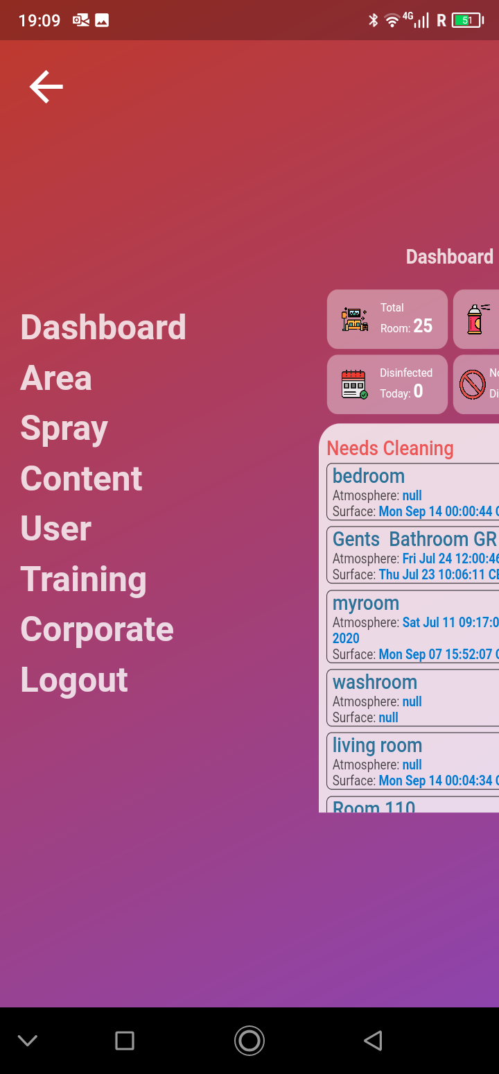
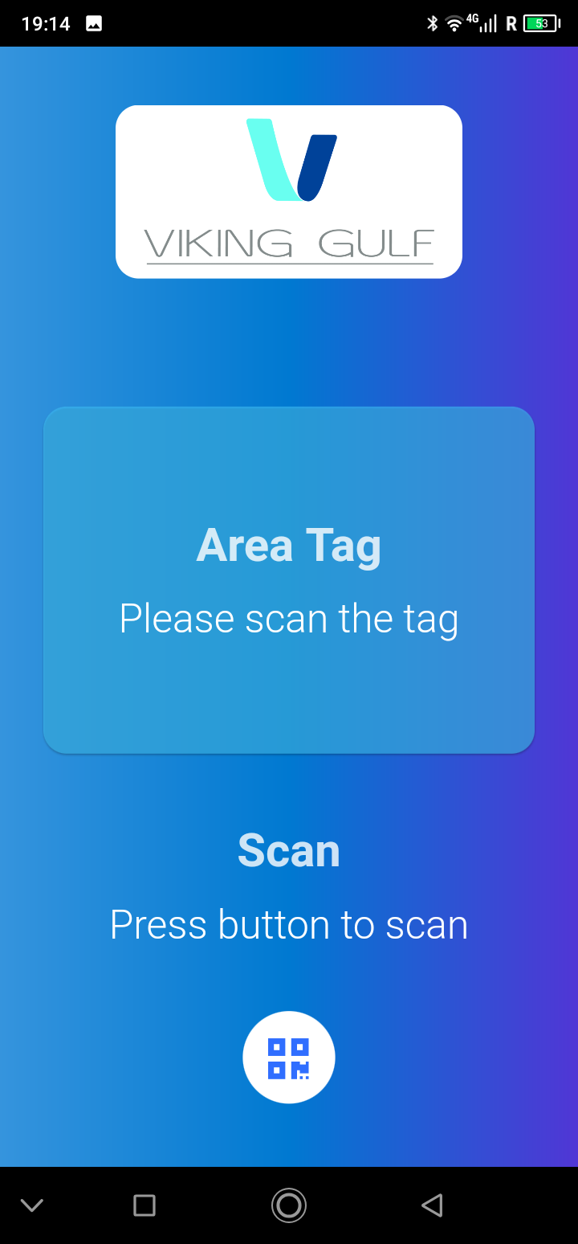
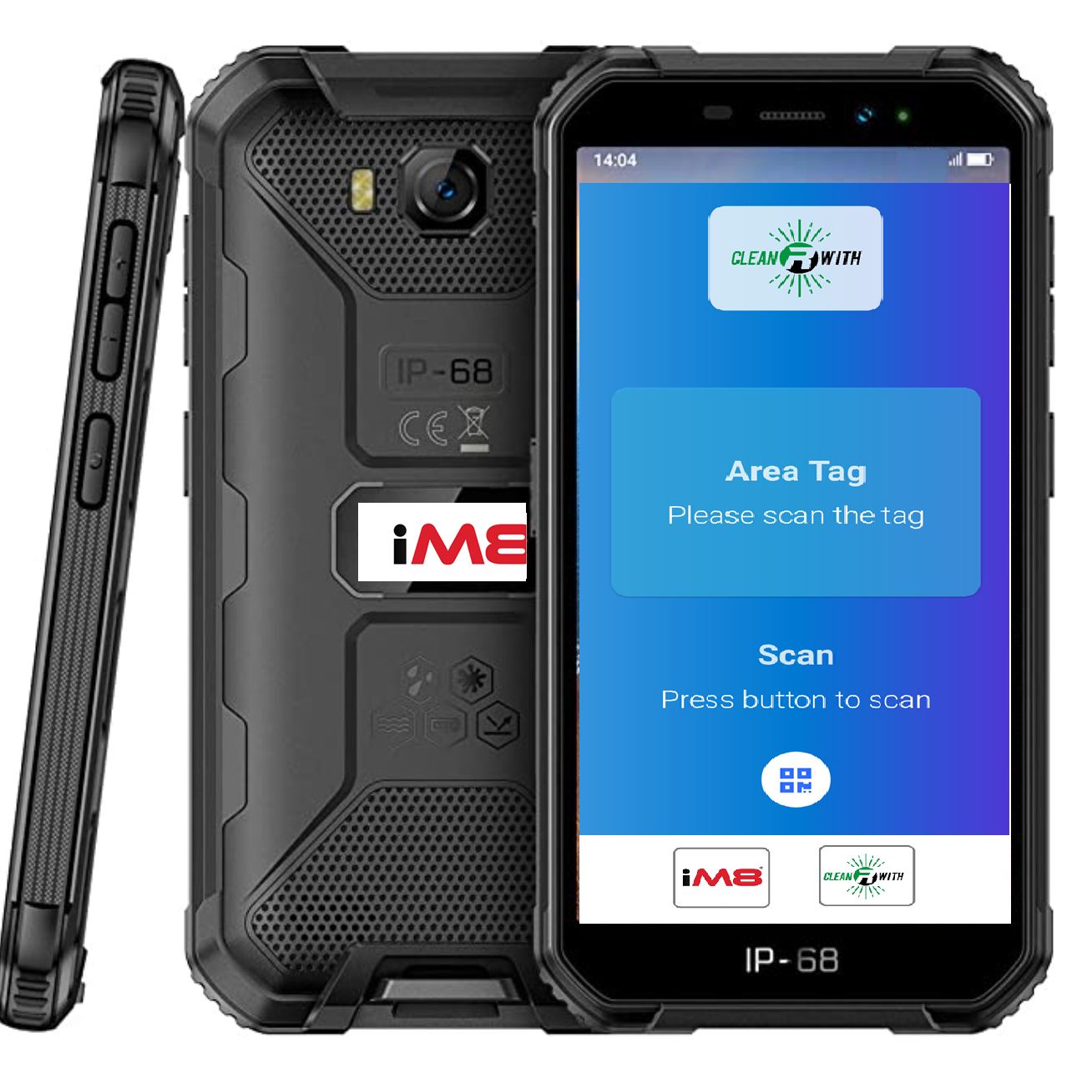
CleanRwith / iM8 Apps and Hardware

Slide 4

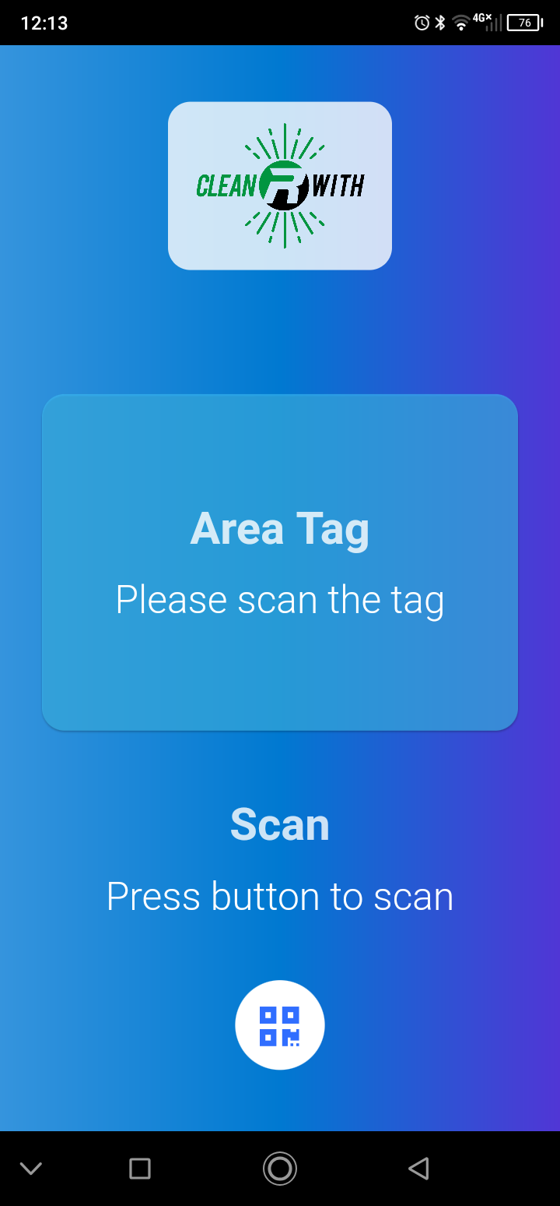
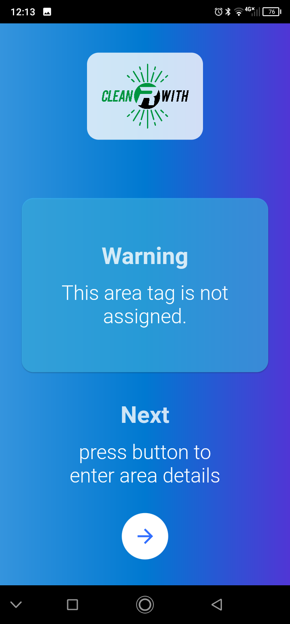
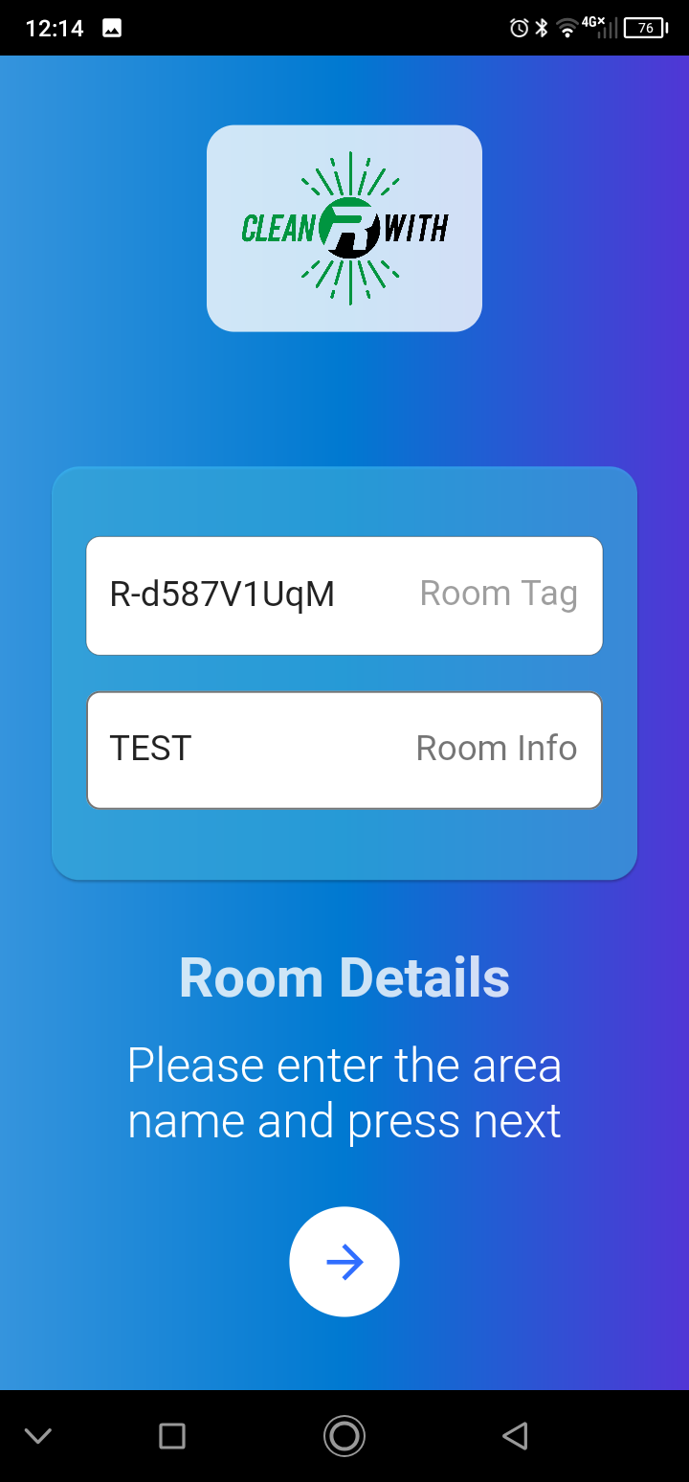
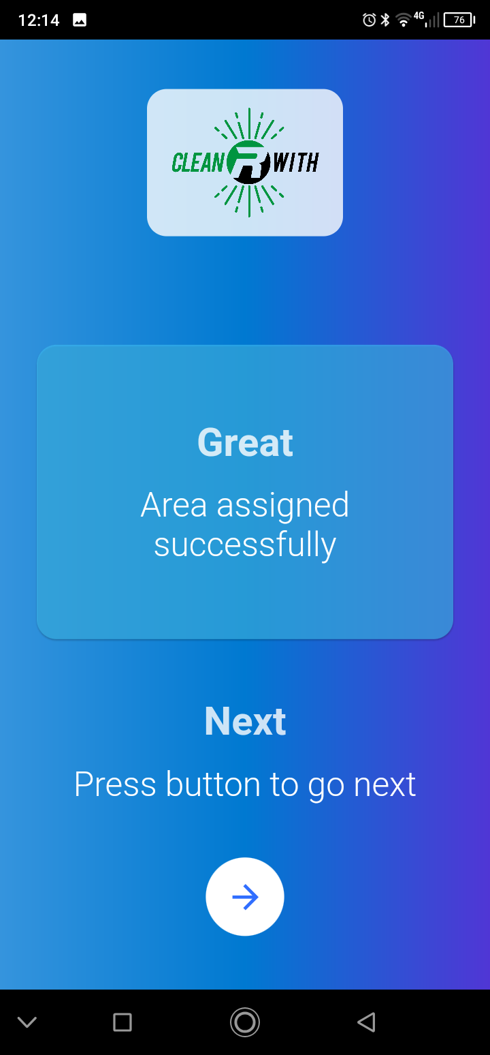


Sanitisation processes recorded via CleanRwith App

Slide 5

OEM Apps

Slide 6
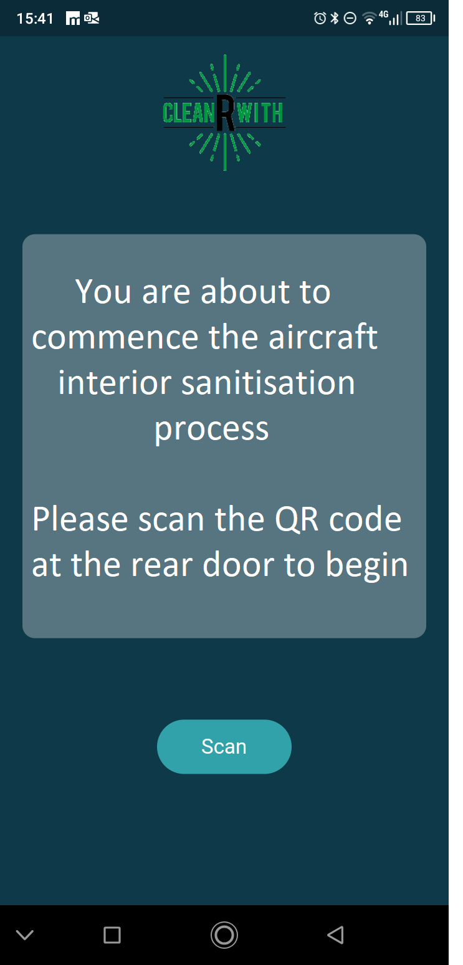
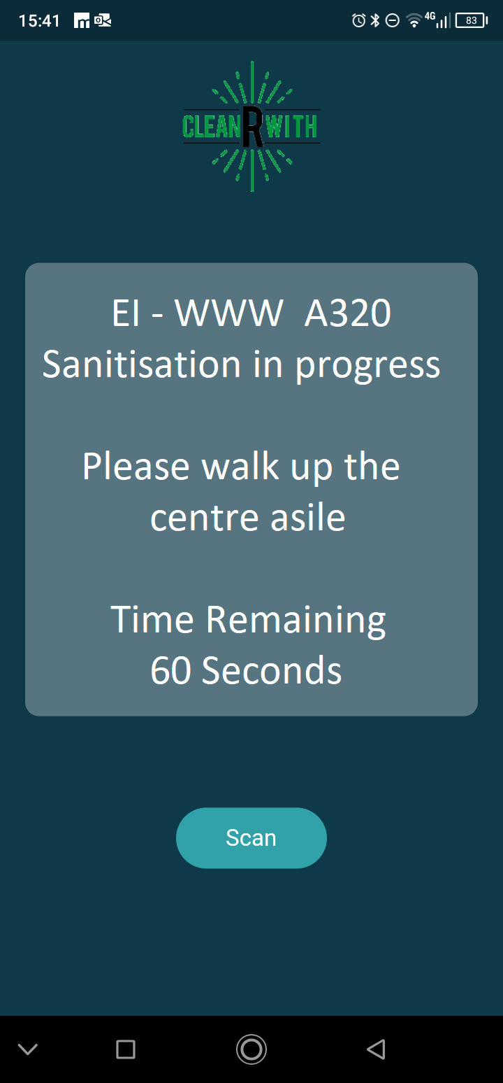
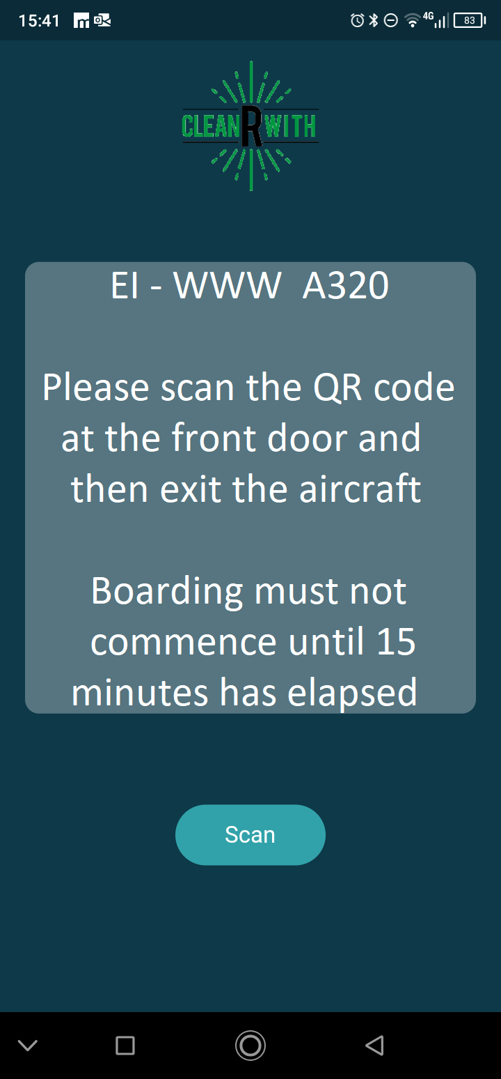
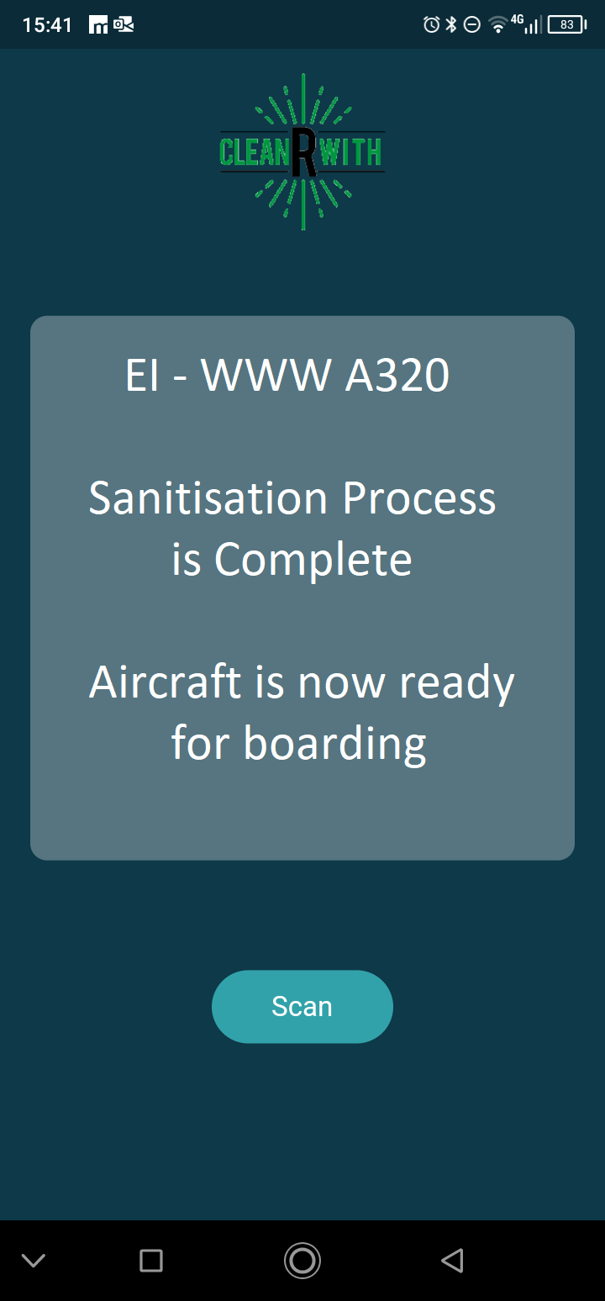

Unique aircraft-interior sanitisation process
Beginning at the rear of the aircraft, the cleaner scans the QR code at the back door
Cleaner deploys the Atmospheric Spray and walks up the cabin
When the cleaner reaches the front door of the aircraft, they scan the QR code on the bulkhead to complete the process
The aircraft is empty and the tabletops are all down
The app will assist the cleaner by showing a timer
The cleaner exits the aircraft
A message is sent to the cleaners phone when 15 minutes has elapsed and the aircraft is ready for occupation

Slide 7
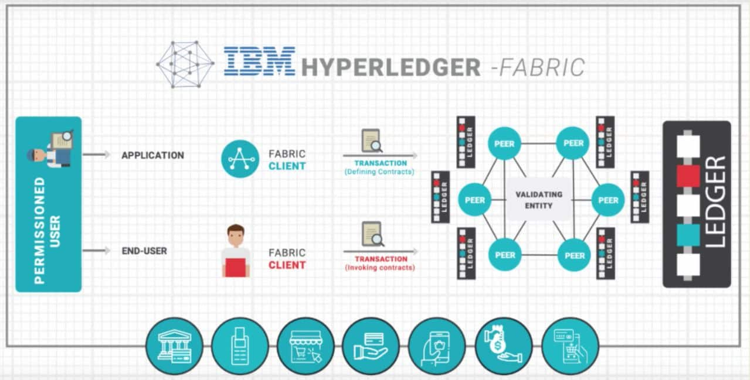
All events are recorded in the iM8 Blockchain

Slide 8
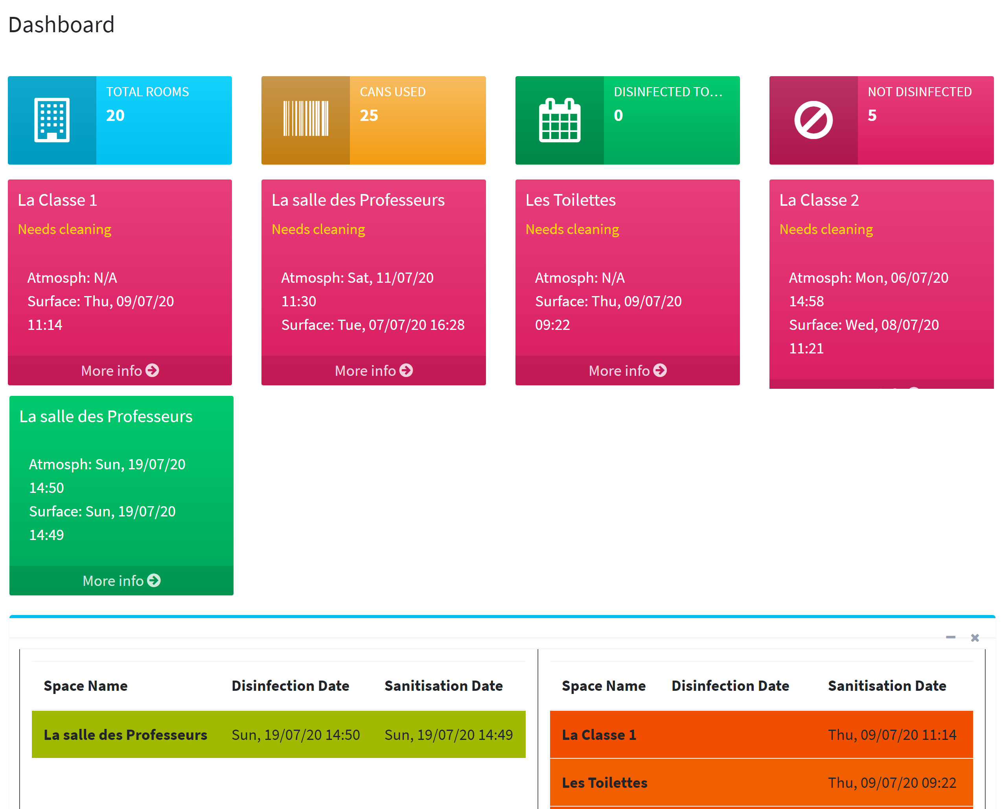
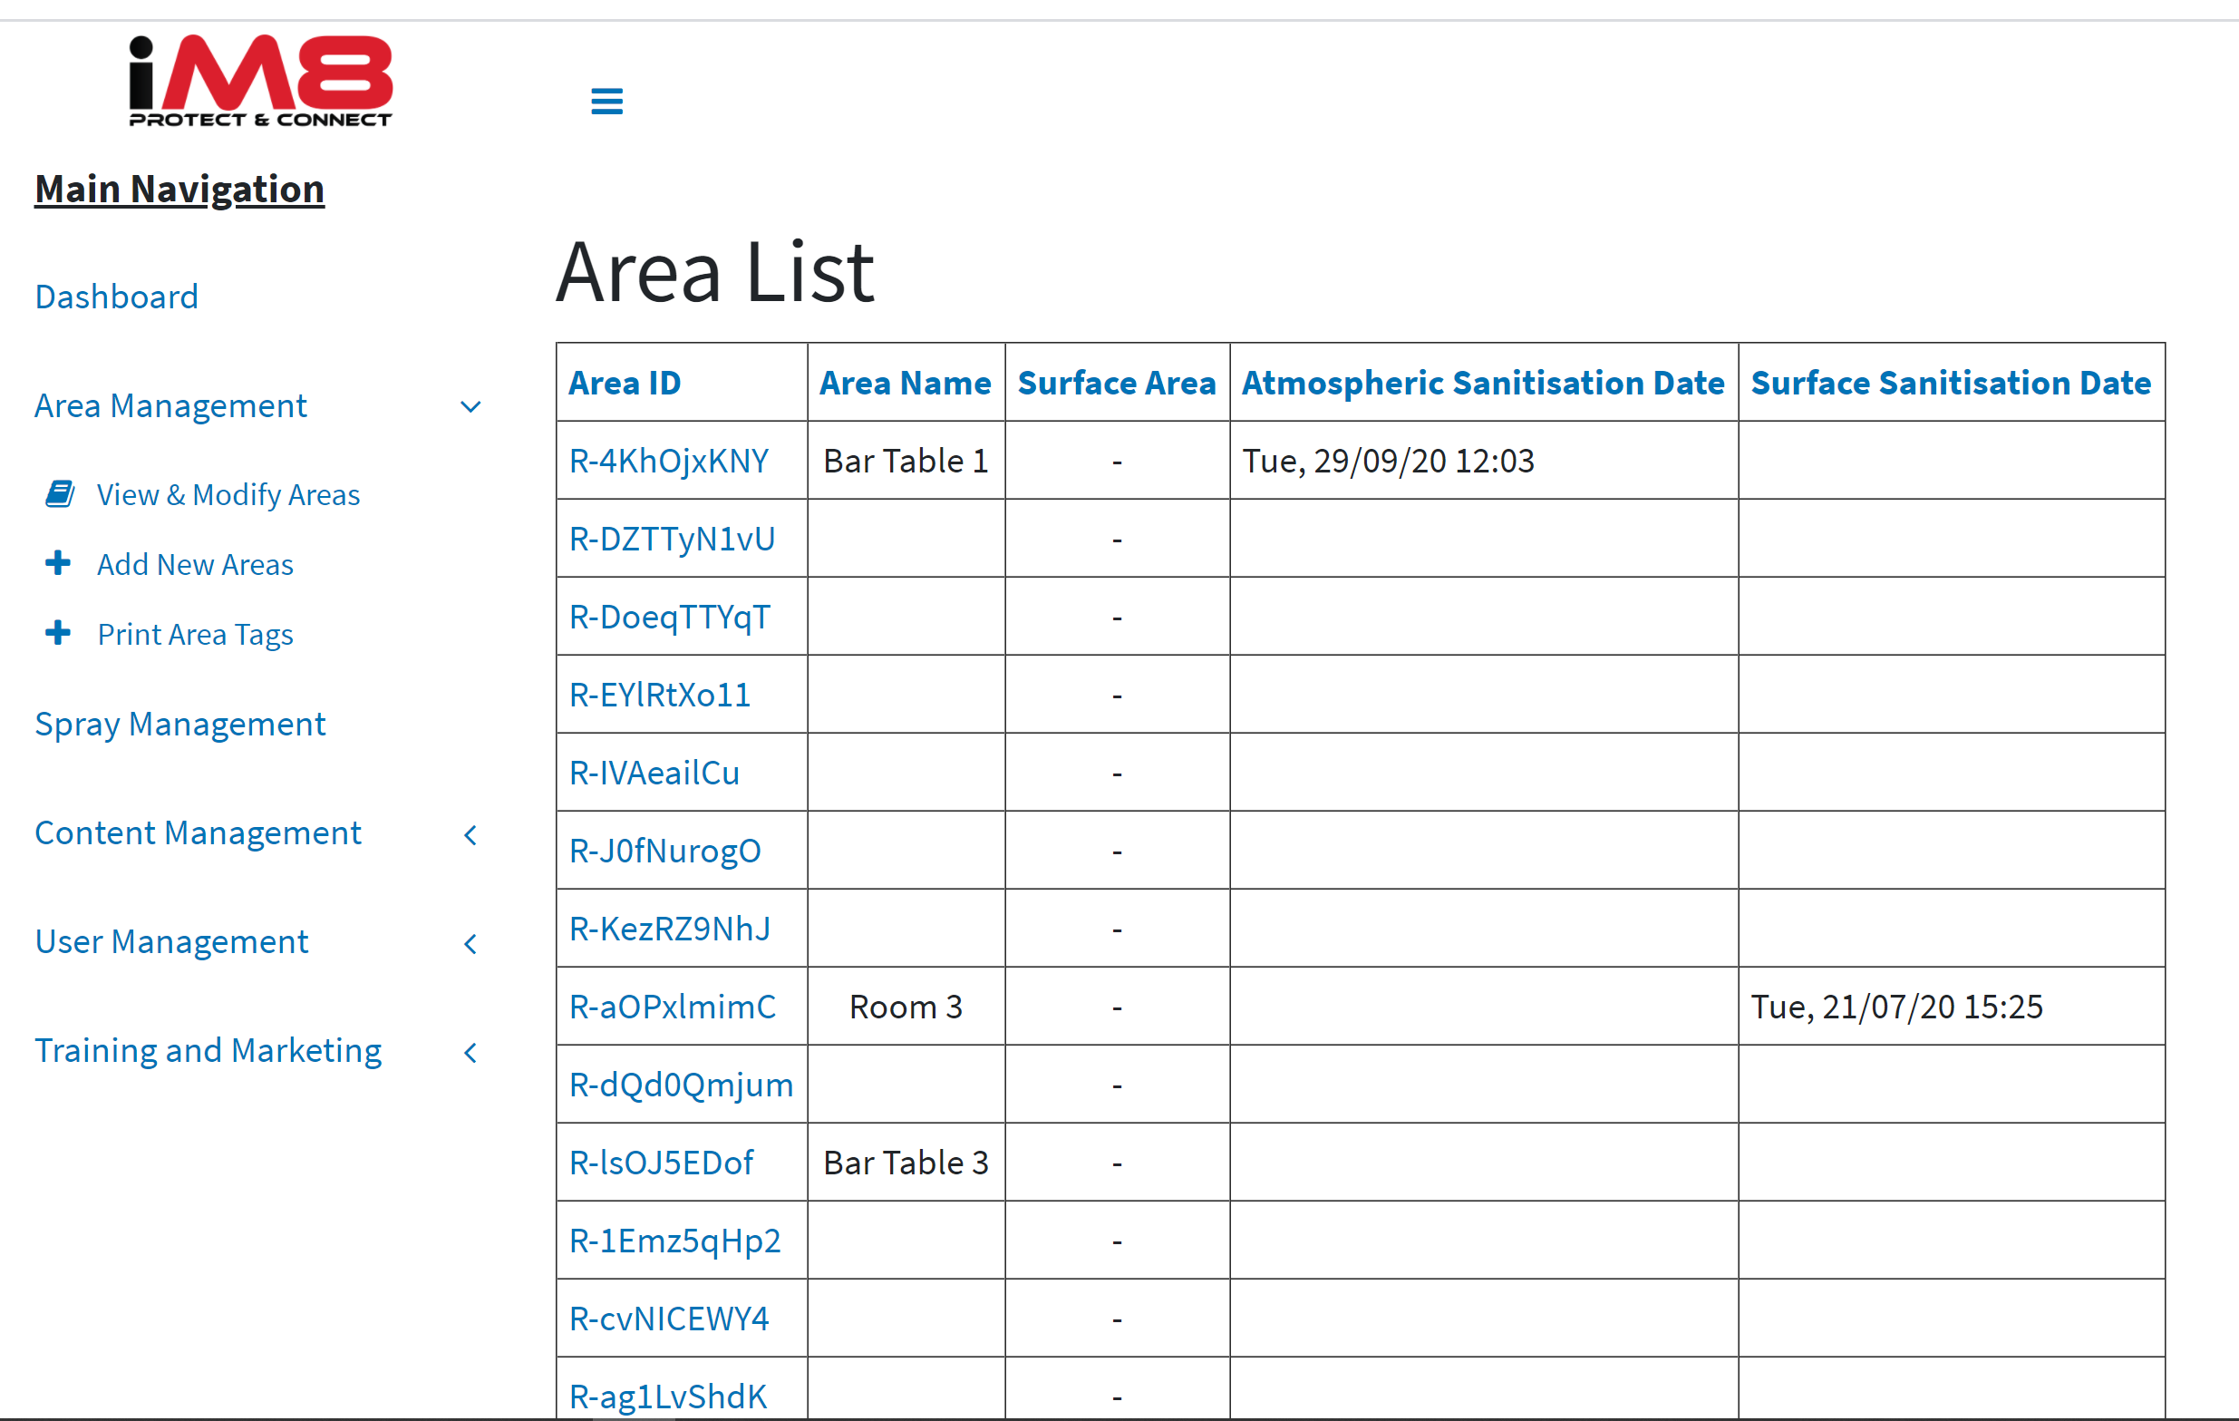
Customer and Reseller Dashboard

Slide 9
Integrated reseller portal
Online Reseller and Distributor Portal (https://fog.im8.world)
Each reseller can:
Add in new customers, assign areas and users
Multiple options for the creation of the area tags
Log any issues
Access all iM8 and CleanRwith training information
Control the content displayed when the customer scans the QR code
Add in additional services for the customer
Access the customer’s dashboard
Pre-print asset tags (in volume) for later assignment
Using the forecast tool, set up an automated ordering process (Sept release)
Order product with automated invoicing (Sept release)

Slide 10
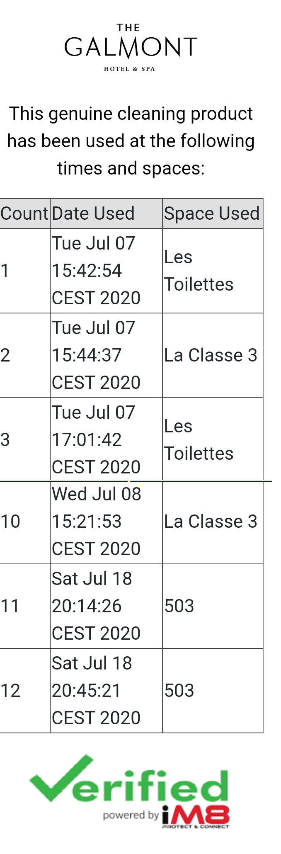
Product Usage Tracking
We track and record every time a multi use surface cleaner is used

Slide 11
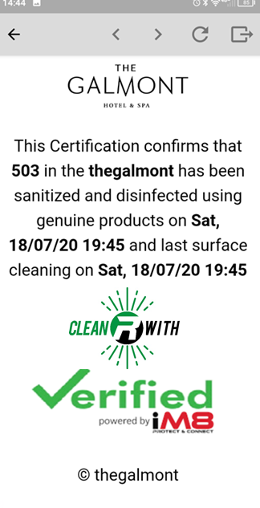
Product Usage Tracking
We also track and record every time a fogger is used, either on its own or in conjunction with a multi use surface cleaner

Slide 12
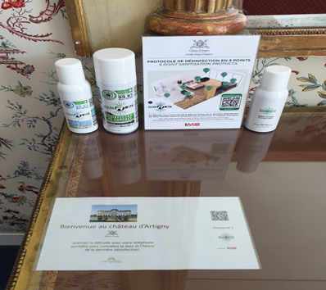
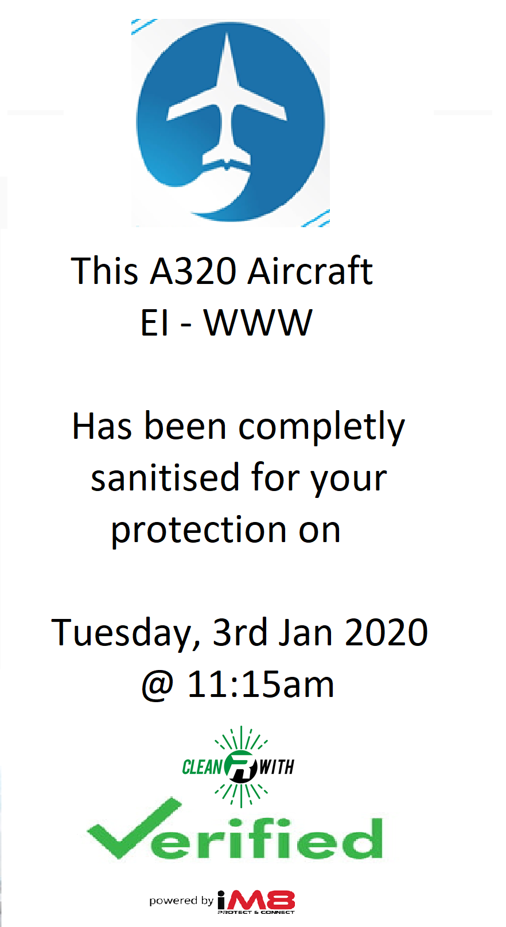

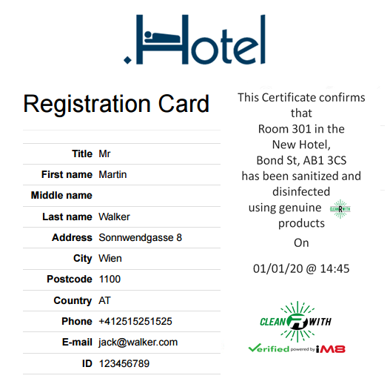
Customer Verification

Slide 13
Data Capture
Every aspect of the client’s sanitisation process is captured within the iM8 Blockchain database
All reporting data is available on the iM8 dashboard using the iM8 web portal and on mobile using the iM8 App
Custom reporting is available and can be delivered by email, WhatsApp and other messaging technology
Exception reporting is configurable via the client web portal

Slide 14
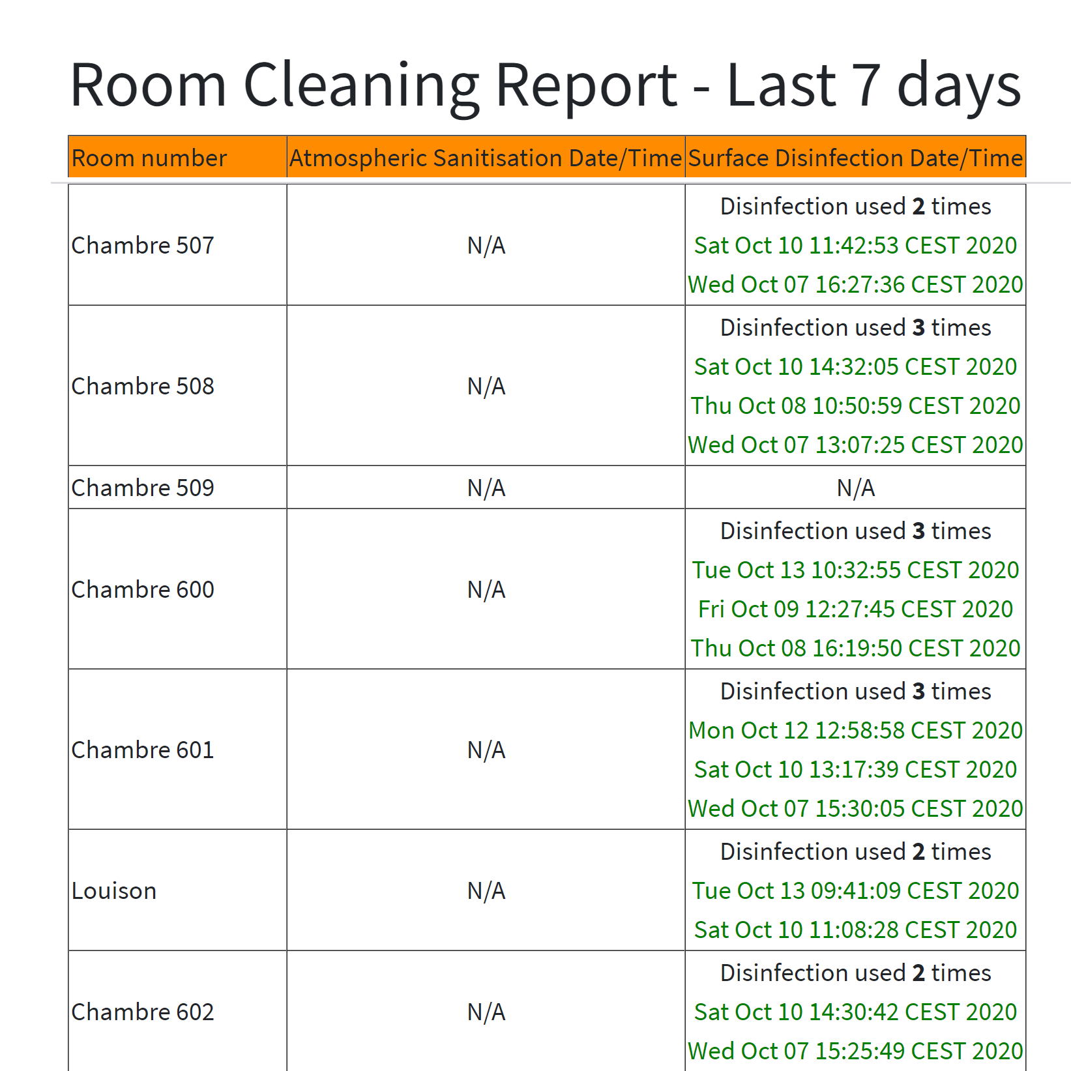
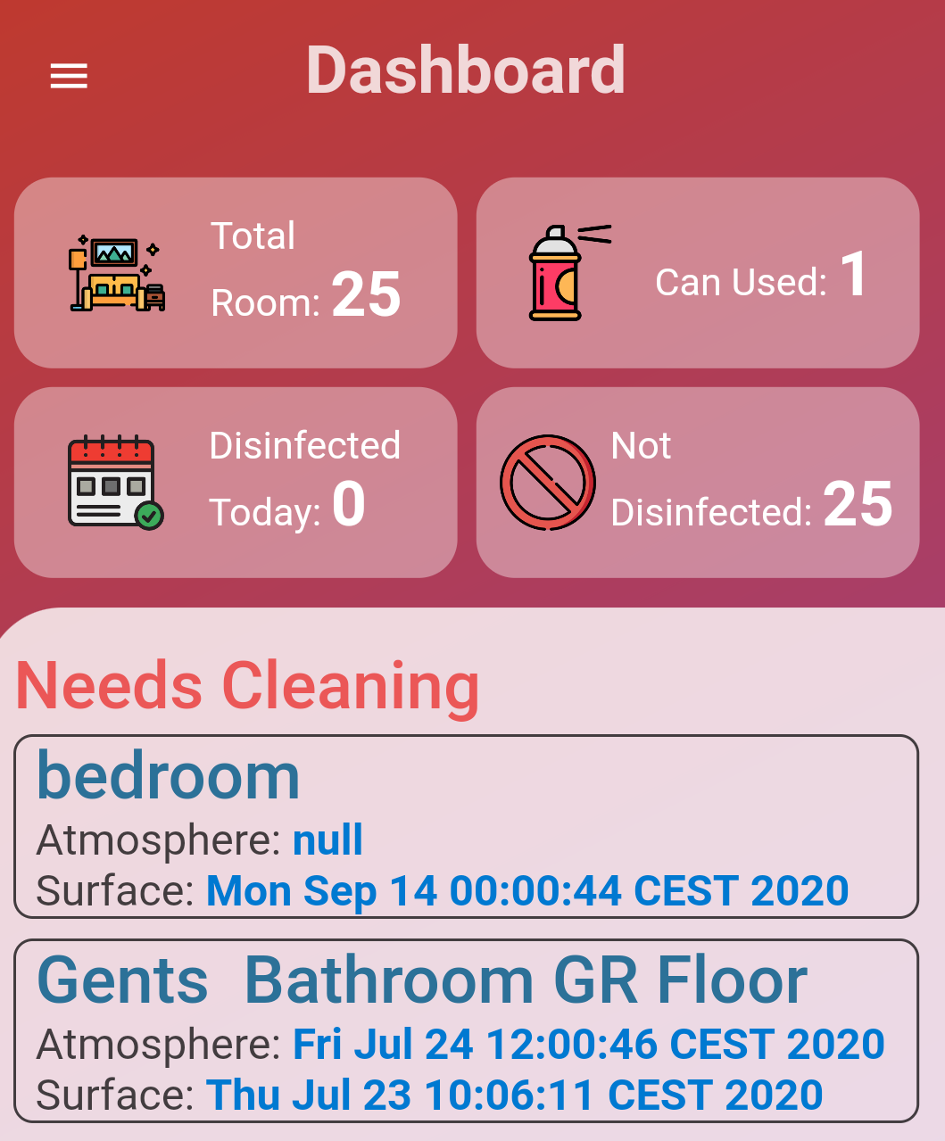
Data Capture & Reporting
Client Level Reporting
Area sanitisation information, by area, date, time (optional by whom)
KPI’s, median sanitisation time, adherence to protocol, area availability, product usage
Sanitisation product usage by product type, size
Product use estimator (estimates product usage based on customer profile and area configuration)
Product use tracking (allows for automated re-ordering)
Customer scan logging, by area, date, time, click through

Slide 15
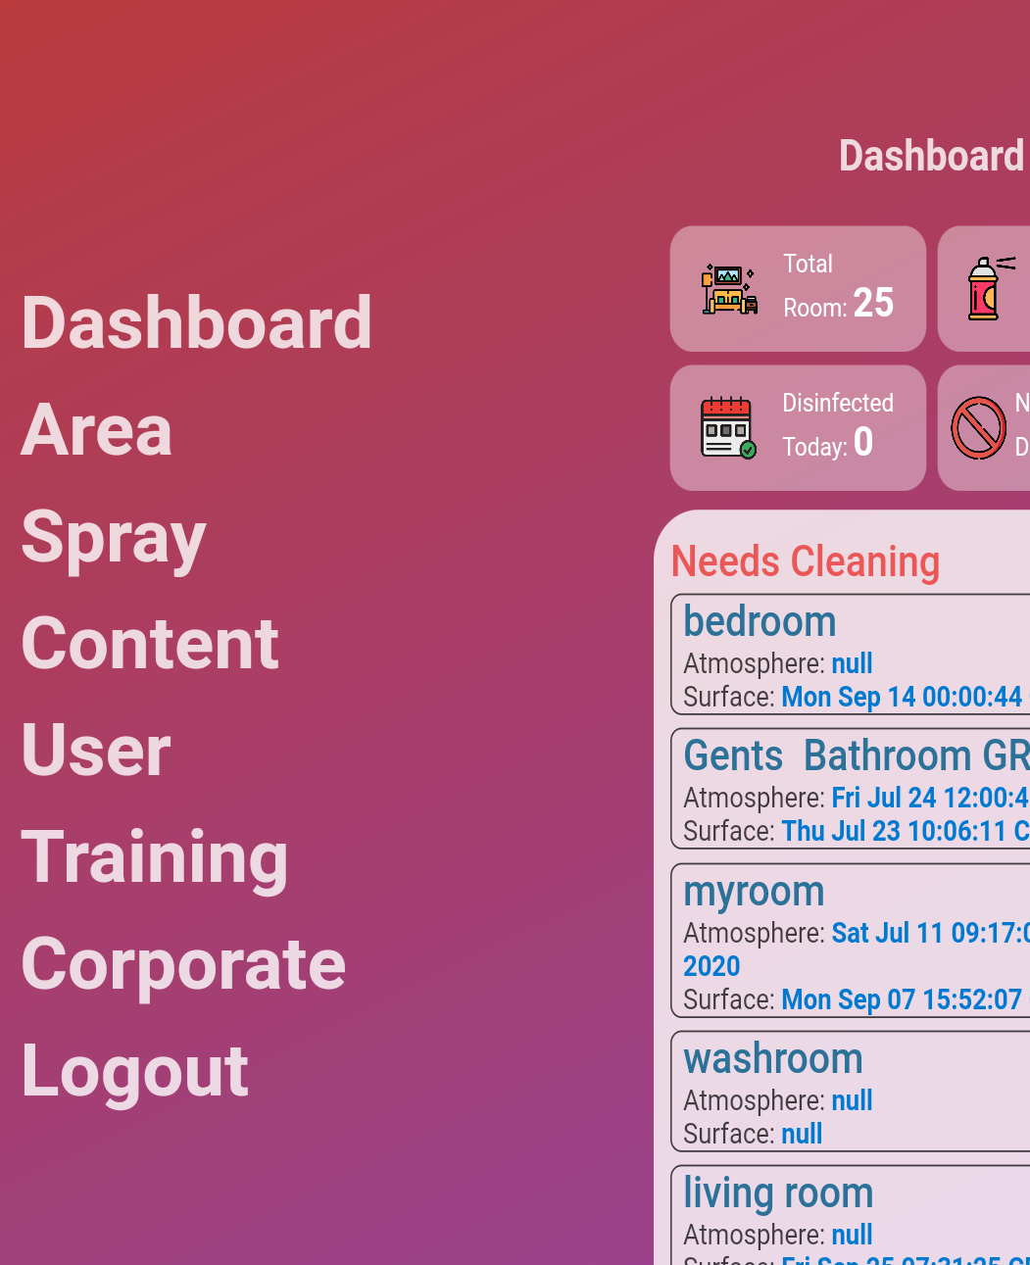
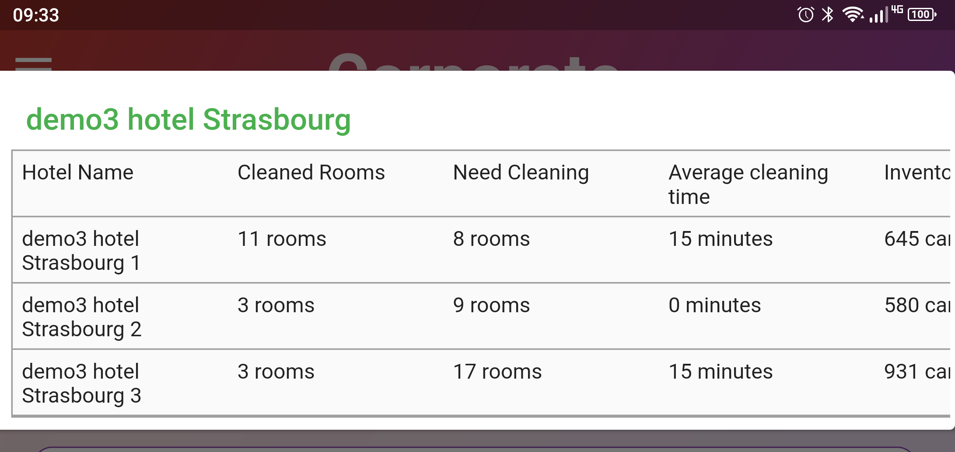
Data Capture & Reporting
Corporate Level Reporting
Analysis of customer portfolio at group level
Group levels configurable by geography, function and custom
KPI reporting, policy adherence, sanitisation process analysis, sanitisation time, product usage
Benchmark against corporate protocol
Available via the iM8 web portal and App

Slide 16
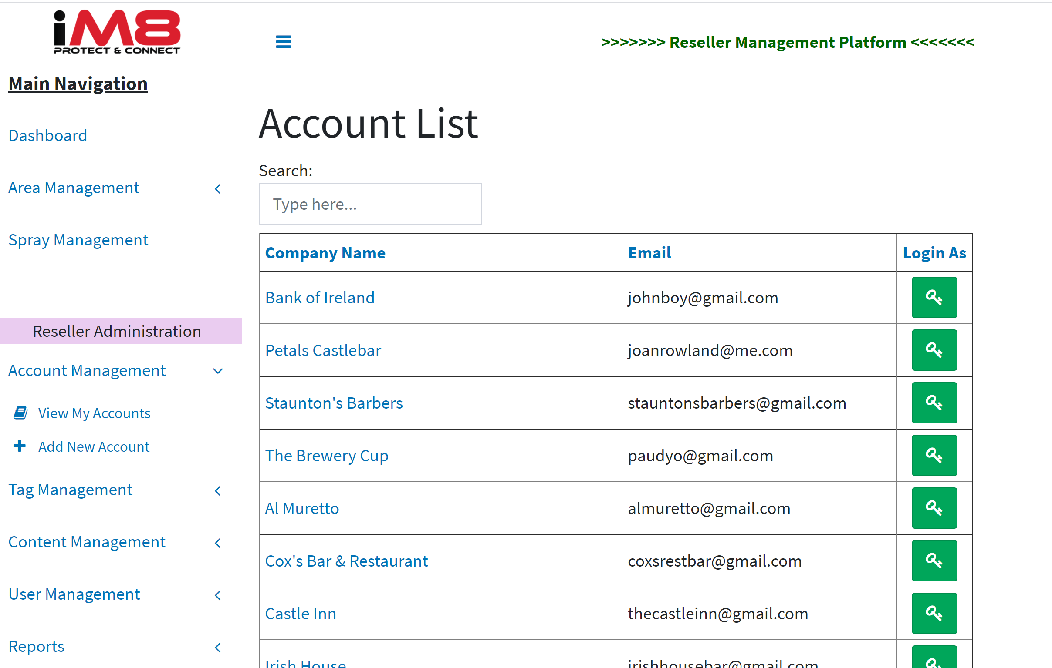
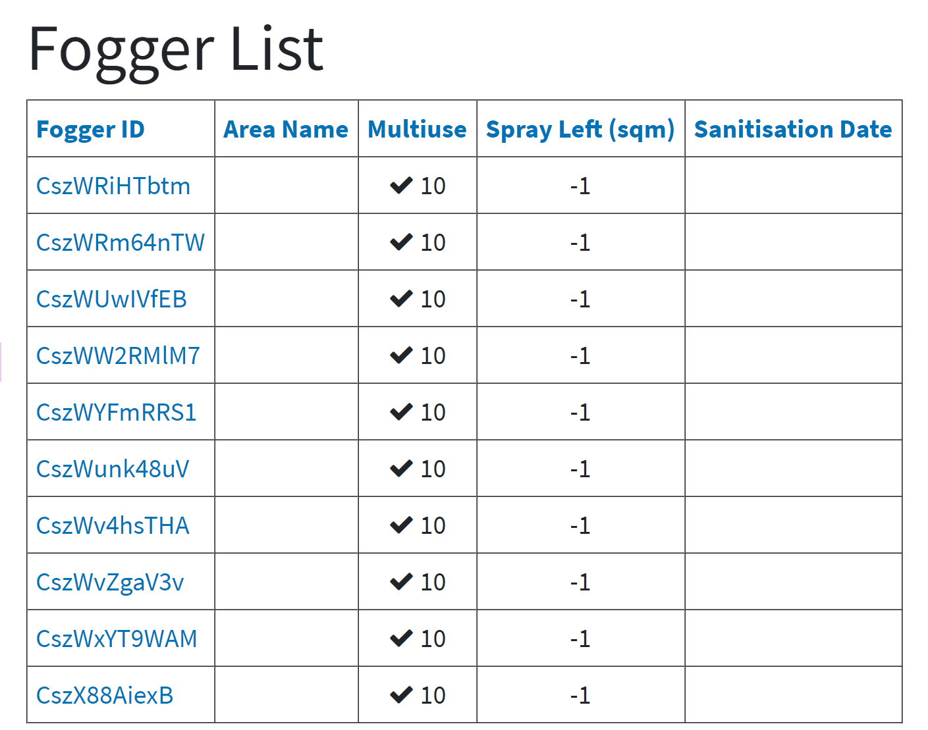
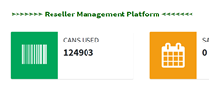
Data Capture & Reporting
Reseller Level
Product usage by client, individual and grouped
Product usage forecaster
Area / Product configurator (to manage usage)
Customer scanning report, by client, geography, area, area type
Client profile, by product, geography, ordering history
Issue log, by client, type
Automated re-order by client, geography

Slide 17
Thank You
©CleanRwith 2020 Strictly Confidential

